Slide 1
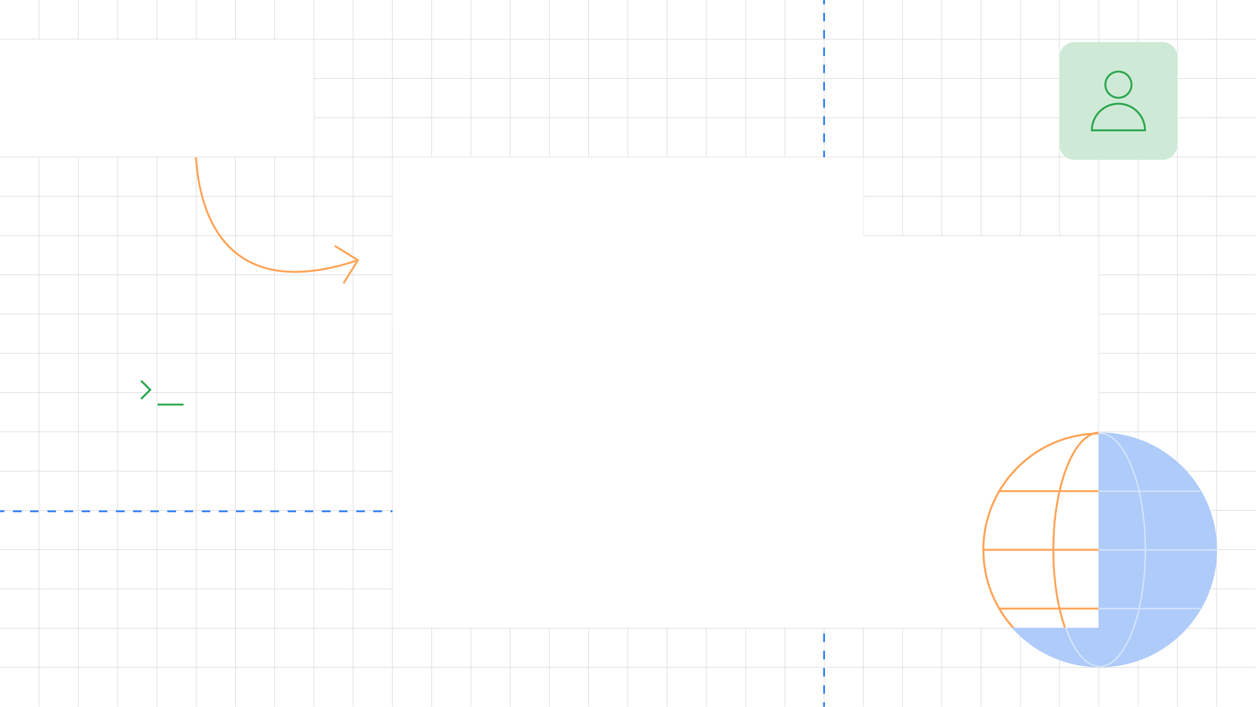



Sentiment Analysis
Lina Alhuri
Laalhuri@gmail.com

Slide 2


What is SA
Identify the orientation of opinion in a piece of text .
it is something human do.
Can be generalized to a wider set of emotions
The movie
was fabulous!
The movie
stars Mr. X
The movie
was horrible!

Slide 3

Is sentiment really but ?
neutral
“Headlong’s adaptation of George Orwell’s ‘Nineteen Eighty-Four’ is such a sense-overloadingly visceral experience that it was only the second time around, as it transfers to the West End, that I realised quite how political it was. Writer-directors […] have reconfigured Orwell’s plot, making it less about Stalinism, more about state-sponsored torture. Which makes great, queasy theatre, as Sam Crane’s frail Winston stumbles through 101 minutes of disorientating flashbacks, agonising reminisce, blinding lights, distorted roars, walls that explode in hails of sparks, […] and the almost-too-much-to-bear Room 101 section, which churns past like ‘The Prisoner’ relocated to Guantanamo Bay. […] Crane’s traumatised Winston lives in two strangely overlapping time zones – 1984 and an unspecified present day. The former, with its two-minute hate and its sexcrime and its Ministry of Love, clearly never happened. But the present day version, in which a shattered Winston groggily staggers through a 'normal' but entirely indifferent world, is plausible. Any individual who has crossed the state – and there are some obvious examples – could go through what Orwell’s Winston went through. Second time out, it feels like an angrier and more emotionally righteous play. Some weaknesses become more apparent second time too.”
positive
negative?
Neutral?
Notes:
http://www.timeout.com/london/theatre/1984-3

Slide 4
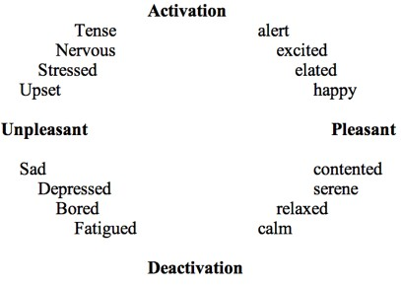
More than binary (example)
Notes:
Distress
https://en.wikipedia.org/wiki/File:Two_Dimensions_of_Emotion.gif.jpg

Slide 5
A field of study with many names
Opinion mining
Sentiment analysis
Sentiment mining
Subjectivity detection
...
Often used synonymously
Some shadings in meaning
“sentiment analysis“ describes the current mainstream task best 🡺 I‘ll use this term.

Slide 6
Terms
Sentiment
A thought, view, or attitude, especially one based mainly on emotion instead of reason
Sentiment Analysis
aka opinion mining
use of natural language processing (NLP) and computational techniques to automate the extraction or classification of sentiment from typically unstructured text
Notes:
1. Subjective vs objective information
2. Essentially the same as other information retrieval tasks, but with some additional challenges as we will see

Slide 7
Motivation
Consumer information
Product reviews
Marketing
Consumer attitudes
Trends
Politics
Politicians want to know voters’ views
Voters want to know policitians’ stances and who else supports them
Social
Find like-minded individuals or communities
Notes:
Review info from blogs, newsgroups, etc
Consumer attitudes towards
-company’s products
-competitor’s products
Politics
-can form basis of policy decisions

Slide 8
Motivation
Knowing sentiment is a very natural ability of a human being.
Can a machine be trained to do it?
SA aims at getting sentiment-related knowledge especially from the huge amount of information on the internet
Can be generally used to understand opinion in a set of documents

Slide 9
Tripod of Sentiment Analysis
Cognitive Science
Sentiment Analysis
Natural Language Processing
Machine Learning
Natural Language Processing
Machine Learning

Slide 10
The unit of analysis
community
another person
user / author
document
sentence or clause
aspect (e.g. product feature)
“What makes people happy“ example
Phone example

Slide 11
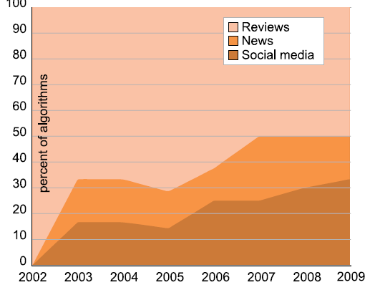
Data sources
Review sites
Blogs
News
Microblogs
From Tsytsarau & Palpanas (2012)

Slide 12

Approaches

Slide 13
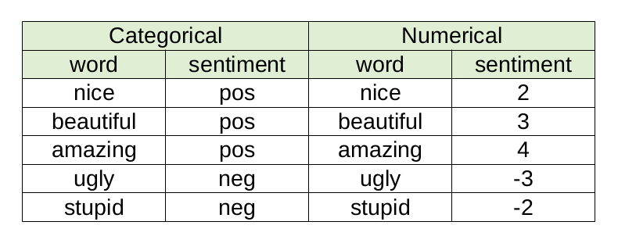
Approaches
Machine learning
Naïve Bayes
SVM
Deep learning
Unsupervised methods
Use lexicons
Hybrid solutions
Each has advantages and disadvantages…
Notes:
Machine learning
Strengths:
-perform fairly well within a given domain with sufficient training data
Weaknesses:
--in a given domain tends to overfit training data; hard to transfer learning to other domains
--need training data
Unsupervised
Strengths
--domain independent; prior polarity
--may aid machine learning techniques
weaknesses:
--when used alone, does not perform as well as machine learning w/in a given domain

Slide 14
Machine-Learning (ML) solutions
‘Learn by example’ paradigm
Provide an algorithm with lots of examples
Documents that have been manually/semi-automatically annotated with a category
Supervised learning
In our case: e.g., positive/negative reviews
Algorithm extracts characteristic patterns for each category and builds a predictive model
Apply model to new text -> get prediction

Slide 15
Machine-Learning solutions
Basic approach:
Get manually annotated documents from the domain you are interested in.
e.g., positive and negative reviews of electronics products
This will be your training corpus
Train any standard classifier using bag-of-words as features
Typical classifiers: Support Vector Machines (SVMs), Naïve Bayes, Maximum Entropy
Naïve Bayes are super-easy to implement from scratch
Don’t try to implement SVMs yourself! Use existing implementations: SVM^{light}, LibSVM or LibLinear (for larger datasets). Use linear kernels
Use boolean features not frequency-based
Apply trained classifier to test corpus or application
If you want to predict a rating, e.g., 1-5 stars [20]
Same as above, but use multi-class classification or regression:
Linear Regression, Support Vector Regression

Slide 16
Crash-course on ML for document classification
Bag-of-words document representation: document -> vector
Example:
d₁=“good average excellent good”
d₂=“okay good average fine”
d₃=“good okay okay”
Then Vocabulary={“good”, “average”, “excellent”, “fine”, “okay”} and d₁ will be represented as:
d₁={2,1,1,0,0} if features are frequently-based or
d₁={1,1,1,0,0} if boolean-based
Problems:
Order of tokens is lost
Long-distance relationships are lost
“Avengers was a good movie, but Iron Man sucked!”

Slide 17
Documents in a Vector Space - Classification
Sec.14.1
negative
Test document; which category?
positive

Slide 18
Documents in a Vector Space - Classification
Sec.14.1
Example: k-Nearest Neighbours
Example: Support Vector Machines

Slide 19
Lexicon solutions
Lexicon
Step 1
Step 2
All
Instances
Neutral
or
Polar?
Polar
Instances
Contextual
Polarity?
Corpus
19,506
5,671
Classes
positive, negative, both, neutral
Notes:
Going into Step 1 🡪 19,500 instances of words from the lexicon
Step 1 🡪 classifies about 5,600 of them as polar.
These are the instances we classify in Step 2.
Note that because Step 1 is automatic 🡪 there is some noise.
Some neutrals do in fact get passed onto Step 2.
Because of this 🡪 still include the neutral class for the contextual polarity classification in Step 2.

Slide 20
(Basic) lexicon-based approach
Detect emotion in two independent dimensions:
Positive: D_{pos}: {1, 2,… 5}
Negative: D_{neg}: {-5, -4,… -1}
(optional) Predict overall polarity by comparing them :
If D_{pos} > |D_{neg}| then positive
Example: “He is brilliant but boring”
Emotion(‘brilliant’)=+3
Emotion(‘boring’)=-2
Negation detection: “He isn’t brilliant and he is boring”
Emotion(NOT ‘brilliant’) = -2
Decreased by 1 and sign reversed
D_{pos} =+3, D_{neg}=-2 => positive
D_{pos} =+1 (default), D_{neg}=-3 => negative

Slide 21
SentiWordNet SauDiSenti
Lexical resource for sentiment analysis
Saudi dialect lexicon.

Slide 22
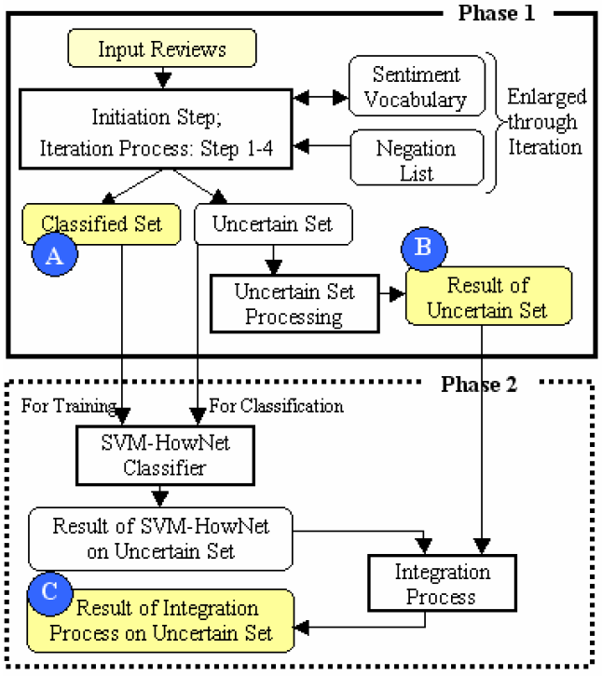
Hybrid solutions
Lexicons + Machine-Learning, e.g., SELC (SElf-Supervised, Lexicon-based and Corpus-based) [11]

Slide 23
Aspect based analysis

Slide 24
Aspect-based Opinion Analysis
As discussed, often the Opinion Object comprises of different aspects
e.g., camera: lens, quality, weight.
Often, such an aspect-based analysis is more valuable than a general +/-
Automatic extraction of those features is possible by:
Building Ontology Trees [25]

Slide 25
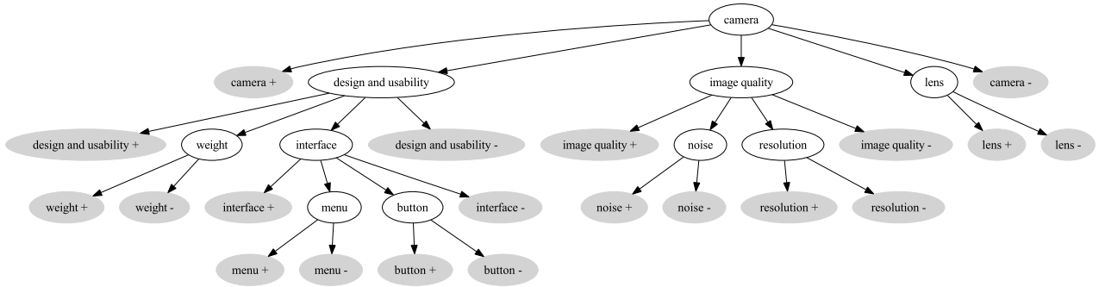

Slide 26
Pros/Cons of the approach
Advantages:
Tend to attain good predictive accuracy
Disadvantages:
Need for training corpus
Solution: automated extraction (e.g., Amazon reviews, Rotten Tomatoes) or crowdsourcing the annotation process (e.g., Mechanical Turk)
Domain sensitivity
Trained models are well-fitted to particular product category (e.g., electronics) but underperform if applied to other categories (e.g., movies)
Solution: train a lot of domain-specific models or apply domain-adaptation techniques
Particularly for Opinion Retrieval, you’ll also need to identify the domain of the query!

Slide 27
Aspect-oriented sentiment analysis: It‘s not ALL good or bad
Yesterday, I bought a Nokia phone and my girlfriend bought a moto phone. We called each other when we got home. The voice on my phone was not clear. The camera was good. My girlfriend said the sound of her phone was clear. I wanted a phone with good voice quality. So I was satisfied and returned the phone to BestBuy yesterday.
Small phone – small battery life.

Slide 28
Objects, aspects, opinions (1)
Yesterday, I bought a Nokia phone and my girlfriend bought a moto phone. We called each other when we got home. The voice on my phone was not clear. The camera was good. My girlfriend said the sound of her phone was clear. I wanted a phone with good voice quality. So I was satisfied and returned the phone to BestBuy yesterday.
Small phone – small battery life.
Object identification

Slide 29
Objects, aspects, opinions (2)
Yesterday, I bought a Nokia phone and my girlfriend bought a moto phone. We called each other when we got home. The voice on my phone was not clear. The camera was good. My girlfriend said the sound of her phone was clear. I wanted a phone with good voice quality. So I was satisfied and returned the phone to BestBuy yesterday.
Small phone – small battery life.
Object identification
Aspect extraction

Slide 30
Find only the aspects belonging to the high-level object
Basic idea: POS and co-occurrence
find frequent nouns / noun phrases
find the opinion words associated with them (from a dictionary: e.g. for positive good, clear, amazing)
Notes:
Popescu, A. and O. Etzioni. Extracting product features and opin-
ions from reviews. In Proceedings of Conference on Empirical Meth-
ods in Natural Language Processing (EMNLP-2005), 2005.

Slide 31
Objects, aspects, opinions (3)
Yesterday, I bought a Nokia phone and my girlfriend bought a moto phone. We called each other when we got home. The voice on my phone was not clear. The camera was good. My girlfriend said the sound of her phone was clear. I wanted a phone with good voice quality. So I was satisfied and returned the phone to BestBuy yesterday.
Small phone – small battery life.
Object identification
Aspect extraction
Grouping synonyms

Slide 32
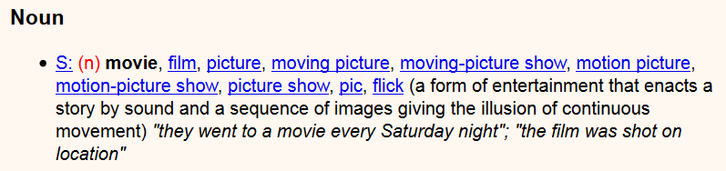
Grouping synonyms
General-purpose lexical resources provide synonym links
E.g. Wordnet
But: domain-dependent:
Movie reviews: movie ~ film
Camera reviews: movie 🡪 video; picture 🡪 photos

Slide 33
Objects, aspects, opinions (4a)
Yesterday, I bought a Nokia phone and my girlfriend bought a moto phone. We called each other when we got home. The voice on my phone was not clear. The camera was good. My girlfriend said the sound of her phone was clear. I wanted a phone with good voice quality. So I was satisfied and returned the phone to BestBuy yesterday.
Small phone – small battery life.
Object identification
Aspect extraction
Grouping synonyms
Opinion orientation classification

Slide 34
Objects, aspects, opinions (4b)
Yesterday, I bought a Nokia phone and my girlfriend bought a moto phone. We called each other when we got home. The voice on my phone was not clear. The camera was good. My girlfriend said the sound of her phone was clear. I wanted a phone with good voice quality. So I was satisfied and returned the phone to BestBuy yesterday.
Object identification
Aspect extraction
Grouping synonyms
Opinion orientation classification

Slide 35
Objects, aspects, opinions (5)
Yesterday, I bought a Nokia phone and my girlfriend bought a moto phone. We called each other when we got home. The voice on my phone was not clear. The camera was good. My girlfriend said the sound of her phone was clear. I wanted a phone with good voice quality. So I was satisfied and returned the phone to BestBuy yesterday.
Small phone – small battery life.
Object identification
Aspect extraction
Grouping synonyms
Opinion orientation classification
Integration / coreference resolution

Slide 36
Not all sentences/clauses carry sentiment
Yesterday, I bought a Nokia phone and my girlfriend bought a moto phone. We called each other when we got home. The voice on my phone was not clear. The camera was good. My girlfriend said the sound of her phone was clear. I wanted a phone with good voice quality. So I was satisfied and returned the phone to BestBuy yesterday.
Small phone – small battery life.
Neutral sentiment

Slide 37
Applications

Slide 38
Applications
Review-related analysis
Developing ‘hate mail filters’ analogous to ‘spam mail filters’

Slide 39
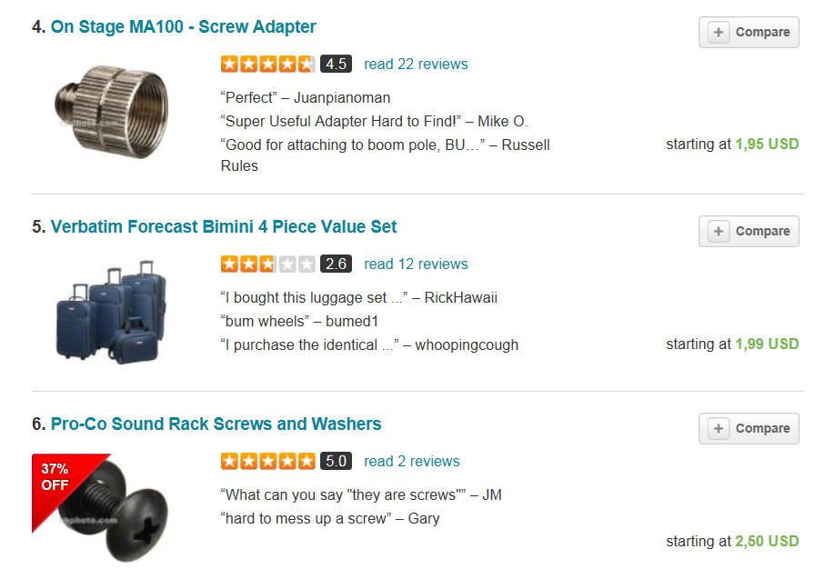
Meet sentiment analysis (1) (buzzilions.com)
Notes:
? Should I show Bing Liu‘s slide on aggregation?

Slide 40
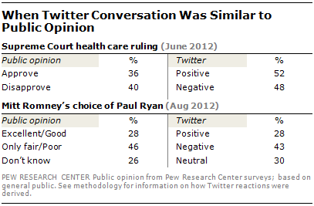
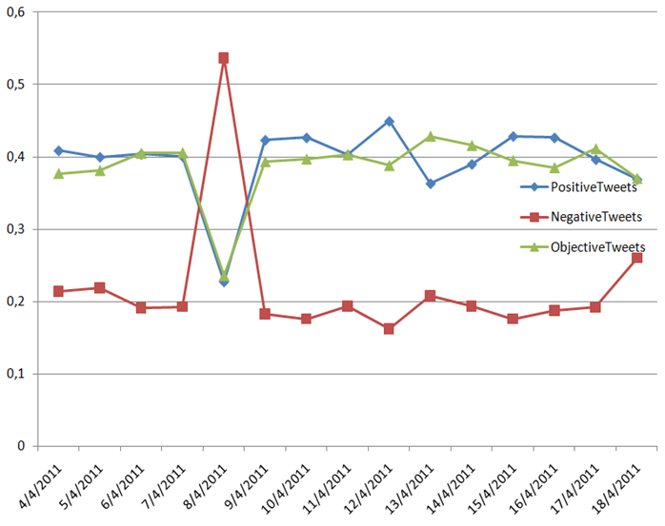
Public Opinion Tracking
Politics
Market
Monitoring of public opinion on Twitter for the keyword “milk”.
Spike occurs on 8/4/2011 after a series of deaths in China relating to bad quality milk (source)

Slide 41
Challenges

Slide 42
Challenges (I)
Subtle ways of expressing private states
“If you are reading this because it is your darling fragrance, please wear it at home exclusively and tape the windows shut” No negative words
“Miss Austen is not a poetess” Fact or opinion?
“Yeah, sure!” Irony
“I feel blue” vs “The sky is blue” Idioms
“If you thought this was going to be a good movie, this isn’t your day” Negation
Informal language
90+% of language used in some social platforms deviates from standard English [3]
“wuddup ,droppin, sum, cuzz luv, u”

Slide 43
Challenges (II)
“This film should be brilliant. It sounds like a great plot, the actors are first grade, and the supporting cast is good as well, and Stallone is attempting to deliver a good performance. However, it can’t hold up” Opinion reversal
“I bought an iPhone a few days ago. It was such a nice phone. The touch screen was really cool. The voice quality was clear too. Although the battery life was not long, that is ok for me. However, my mother was mad with me… ” Topic drift
Domain/context dependence
words/phrases can mean different things in different contexts and domains
This technology is crazy… the patient is going crazy

Slide 44
Special challenges in Tweets
Very popular data source
Mostly public messages
API
But: opaque sampling (“the best 1%“)
Vocabulary, grammar
:‘( …. I am dying
Length restriction

Slide 45
Practical

Slide 46


Thank you
for listening

